Slide 1
Fungi Kingdom
Divisions Chytridiomycota
Divisions Zygomycota
Divisions Ascomycota
Laboratory work 4

Slide 2
Material:
Divisions Chytridiomycota
Class Chytridiomycetes
Order Chytridiales
Olpidium brassicae
Objective:
To investigate the structural features of Olpidium brassicae
Tasks of work:
Draw a cell with plasmodium and zoospore

Slide 3
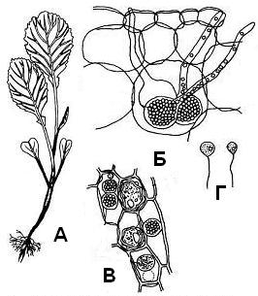
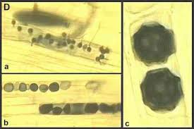
Seedling diseases: cabbage Olpidium brassica
A - affected seedlings; Б - Plasmodium in the cells; B - the formation of zoospores; Г - zoospores
Olpidium brassicae is a plant pathogen, it is a fungal obligate parasite. English names : Olpidium seedling blight, root burn disease

Slide 4
Material:
Divisions Zygomycota
Class Zygomycetes
Order Mucorales
Mucor sp.
mycelium, sporangiophores and sporangia of mucor (live material).
Objective:
familiarize yourself with the structure and development of Zygomycetes
Tasks of work:
Draw the appearance of the mycelium of mucor.
Order of work
Under the binocular consider the colony of mucor with sporangiophores and sporangia.
Prepare a temporary preparation of non-septate mycelium, sporangiophores with immature and mature sporangia. Consider and draw the fragment of mycelium, denote sporangiophores with sporangia.
Draw the Process of Conjugation.

Slide 5
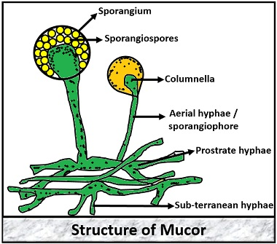
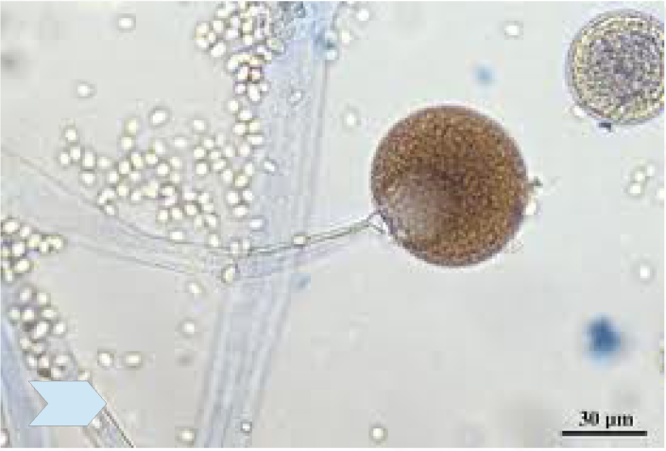
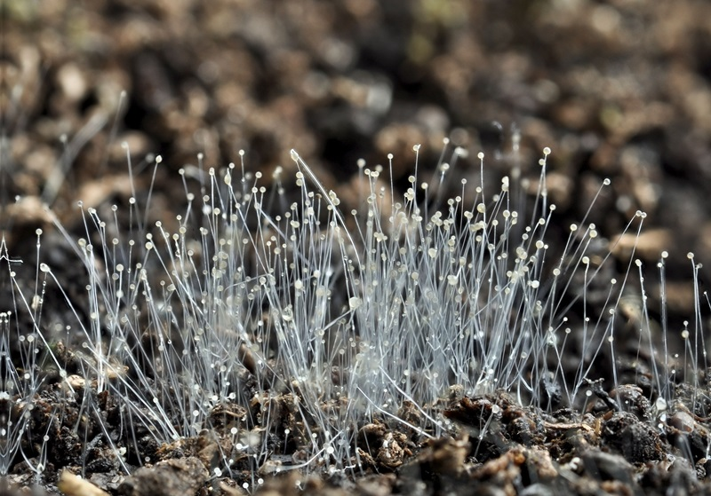
Mucor sp.
Colonies of this fungal genus

Slide 6
Process of Conjugation in genus Mucor

Slide 7
Material:
Divisions Ascomycota
Class Hemiascomycetes
Order Saccharomycetales
Saccharomyces cerevisiae (baker's yeast cells)
Objective:
familiarize yourself with the structure of baker's yeast cells.
Tasks of work:
Draw the budding of baker's yeast cells
Order of work
Prepare a temporary preparation and examine baker's yeast cells. Find budding cells.

Slide 8
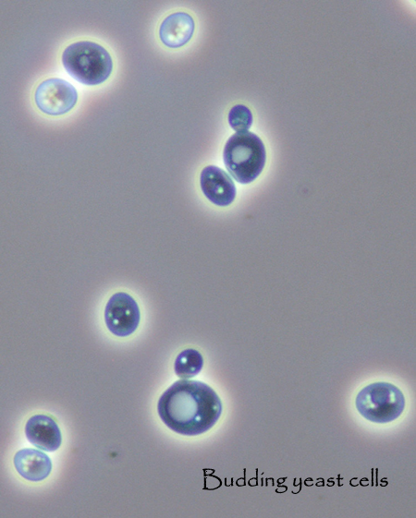
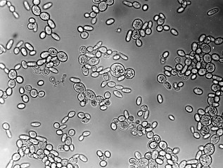
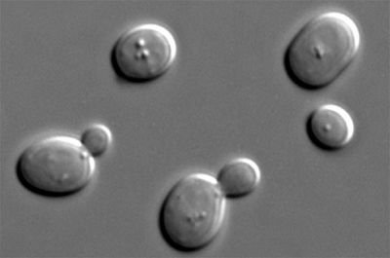
Budding yeas

Slide 9
Material:
Divisions Ascomycota
Class Plectomycetes
Order Eurotiales (Plectascales, Aspergillales)
Penicillium, Aspergillus
Objective:
familiarize yourself with the structure of Penicillium and Aspergillus
Tasks of work:
draw the appearance of Aspergillus and Penicillium conidiophores.
Order of work
Prepare temporary preparations, consider and draw conidiophores

Slide 10
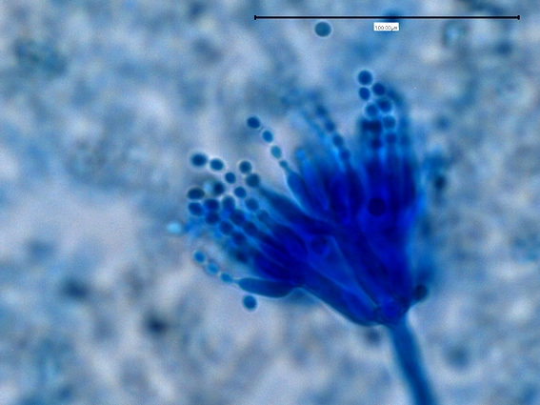
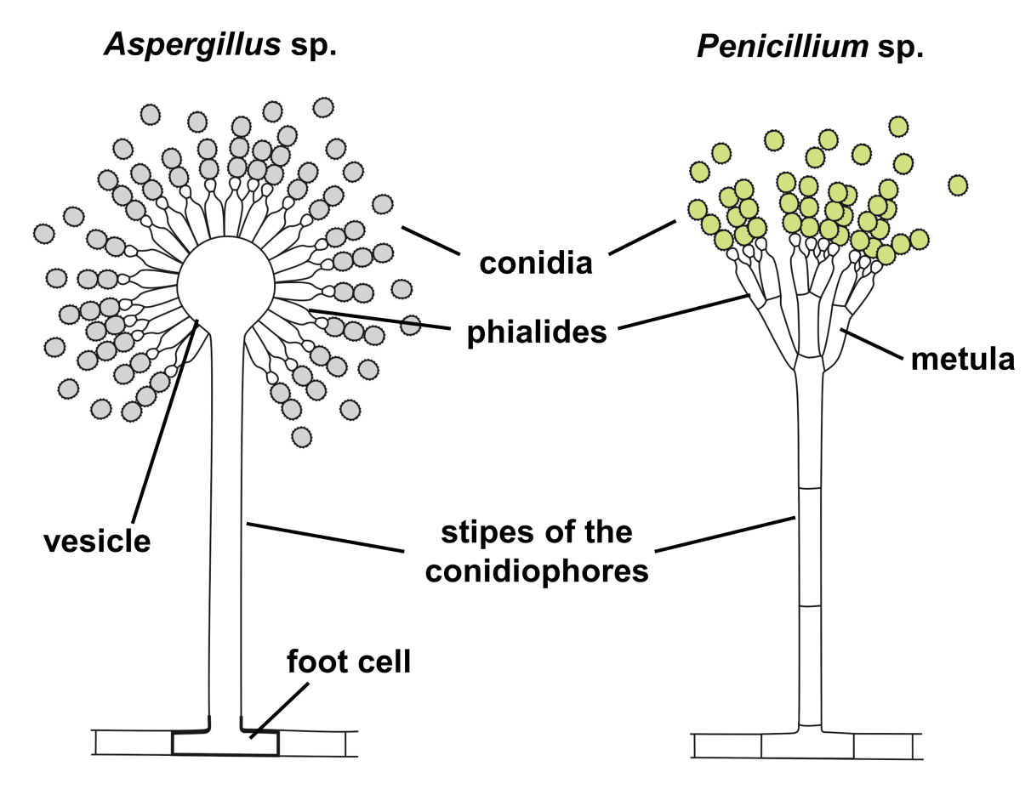
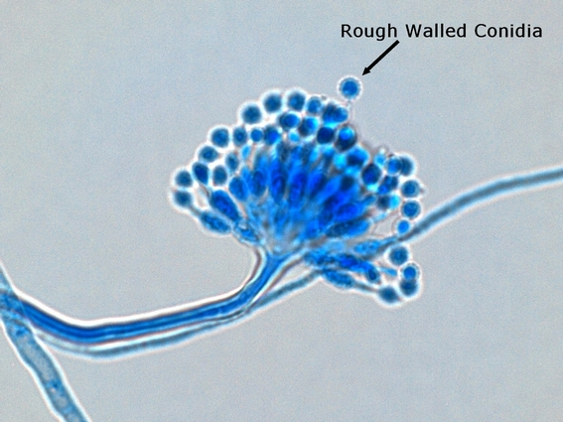
Penicillium
Conidiophores
Aspergillus

Slide 11
I. Penicillium
The genus Penicillium is host to a wide variety of species found in practically all environmental niches. They have been given the name "green mold" or "blue mold", but many Penicillium species possess a variety of colors, textures, and morphological characteristics. The genus gained notoriety after their ability to produce antibiotics, namely penicillin, was discovered in 1941.
Classification in Penicillium is based solely upon conidiophore structure called the penicillus. The penicillus, or "brush", is the whorled structure which bears the single celled conidia.
2. Aspergillus
As with the genus Penicillium, Aspergillus is classified based on the morphology of the conidiophore. The conidiophores are borne on a hyphal cell termed a foot cell. The conidiophore stalk ends with an enlarged vesicle which bears a group of sterigmata. These, in turn, can bear secondary sterigmata called metulae which then bear the conidia in unbranched chains.

